Slide 1
Regular Meeting on 22.06
Wenshuai Zhao, Junyi, Shi, Yukun, Yu

Slide 2
Overview
Training Dataset
Human Prediction Method
Collision Avoidance Method
Development environment & simulator
Tutorials
Repositories
Experiments
Conclusion

Slide 3
How to handle training dataset
About “Thor”, mainly using .tsv as dataset
Helmat & motion capture system, special camera: track the motion
Tobii Pro Glasses mobile tracking headset: track eye (intention)
Velodyne: THOR also contains sensor data collected by a 3D lidar and involves a mobile robot navigating the space, record the data of moving robot
How to extract 3D coordinates of an detected object using 3D LiDAR?

Slide 4
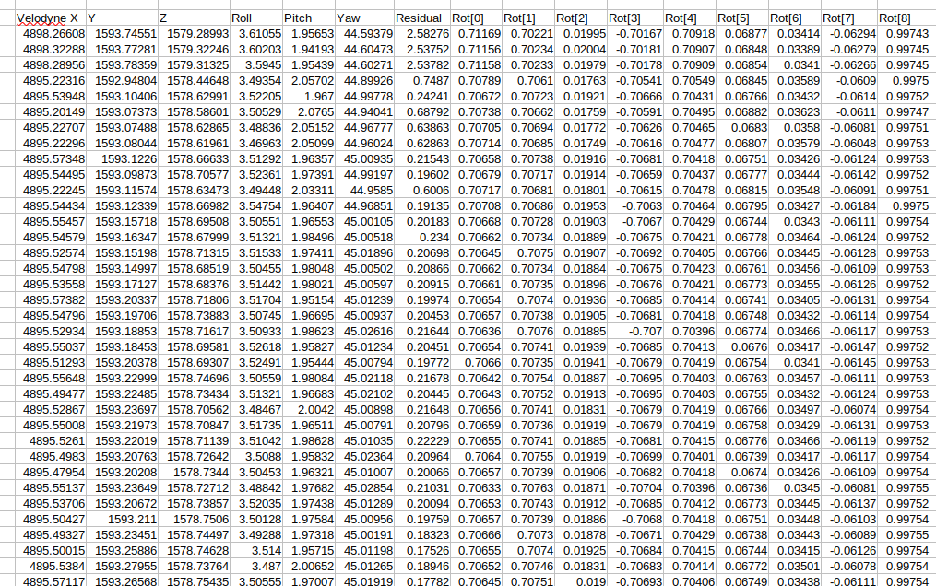

Slide 5
other first-person dataset
Three first-person traffic datasets:
HEV-I
JAAD
PIE
Several prediction methods:
BiTrap
trajectron++(more focus on prediction of vehicle’s action)
SgNet
context-aware_HTP_method

Slide 6
Placing Velodyne
From Thor’s result
Stationary sensors
Stationary 3D LiDAR was placed in the corner of the room on the height of 1.58 m, synchronized in time with the Qualisys system and the eye-tracking glasses. In the opposite corner, a stationary camera was placed.

Slide 7
Human Trajectory Prediction Method
Detection Methods related to utilization of sensors
camera: past trajectories as input and future bounding box as output(top-view)
BiTraP: Bi-directional Pedestrian Trajectory Prediction with Multi-modal Goal Estimation
LiDAR: obtain past trajectories to obtain the future trajectories/detect pedestrian around the corner or blocked by wall or occlusion
-place on the corner to catch the coordinates of humans and robot
-place on the moving robot to detect changes in the environment

Slide 8
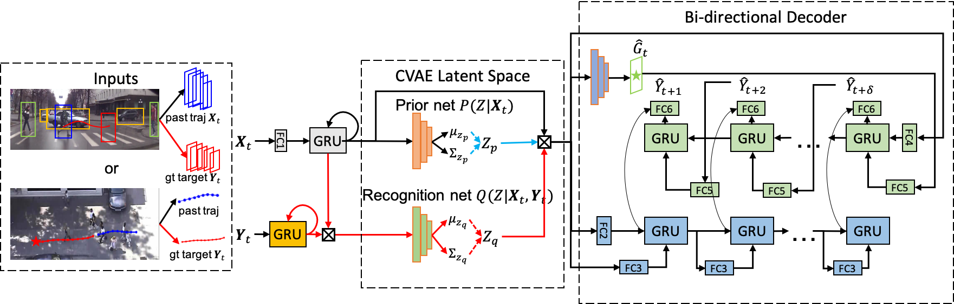
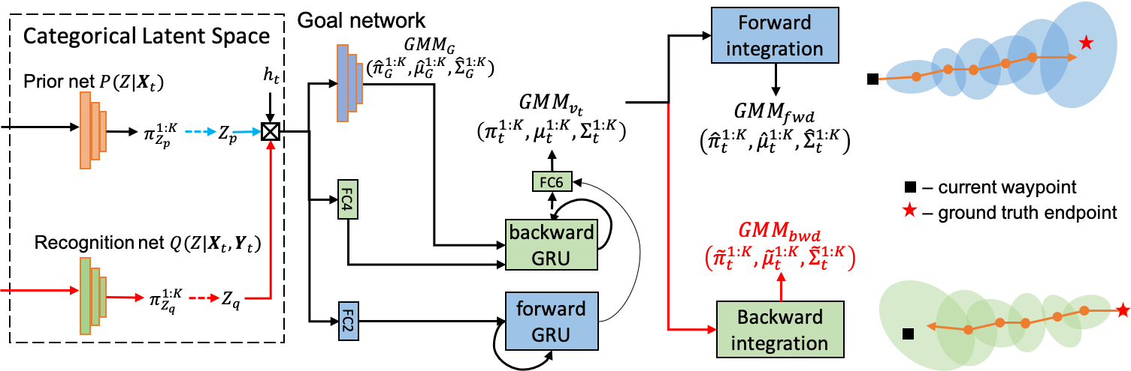
BiTraP: Bi-directional Pedestrian Trajectory Prediction with Multi-modal Goal Estimation

Slide 9
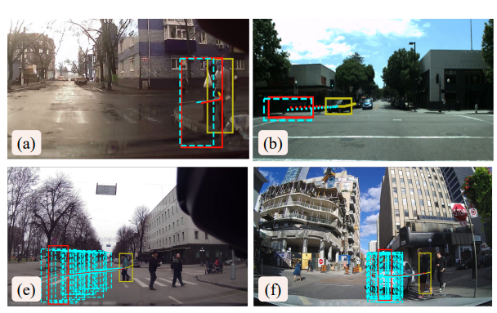
SgNet: Stepwise Goal-Driven Networks for Trajectory Prediction

Slide 10
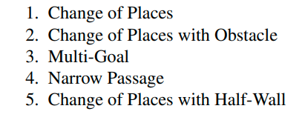
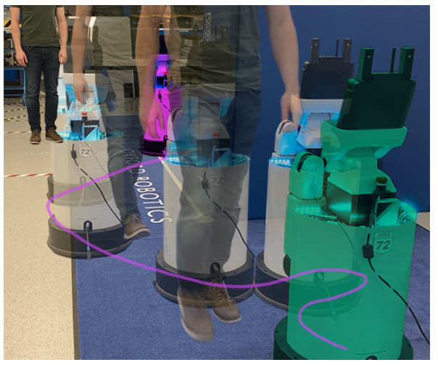
Motion Planning in Dynamic Environments Using Context-Aware Human Trajectory Prediction
This work was based on the research result of Thor to extend.
supplementary video address: https://www.youtube.com/watch?v=gdC3mpZNjG4

Slide 11
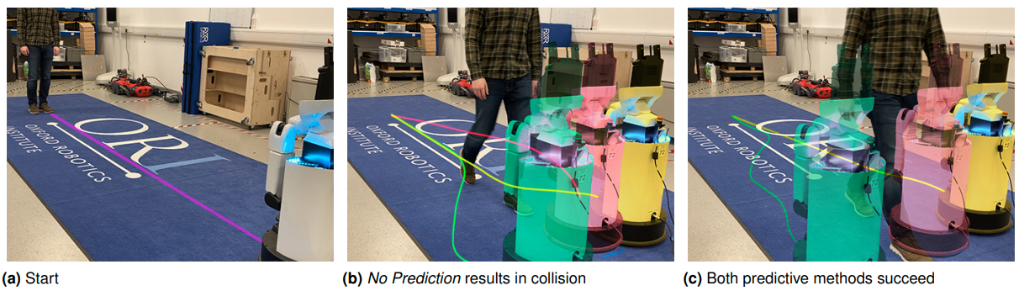
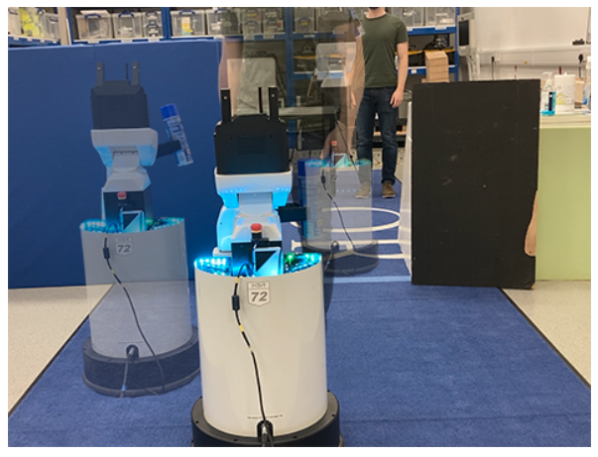
Motion Planning in Dynamic Environments Using Context-Aware Human Trajectory Prediction
Narrow Passage

Slide 12
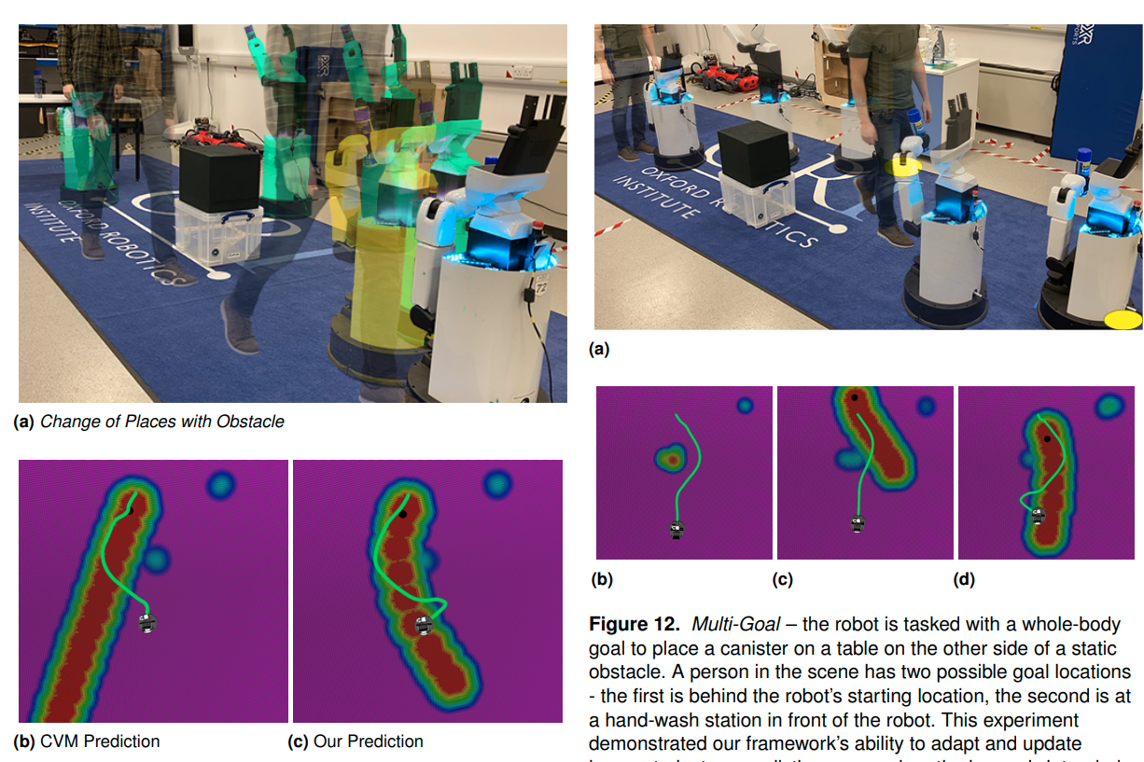
BiTraP: Bi-directional Pedestrian Trajectory Prediction with Multi-modal Goal Estimation

Slide 13
Collision Avoidance Method
Artificial Potential Field, one threshold considered as dangerous area: repo_Oxford
Reinforcement Learning based method:
video link: https://www.youtube.com/watch?v=XHoXkWLhwYQ

Slide 14
Development environment & simulator
environment: ROS
simulator: Gazebo
gazebo simulator repo: https://github.com/chvmp/champ.git
how to make use of this repo?
errors exist when running this repo
is there any other repo/tutorials for spot?
report.bag in exer2 of Thor recorded most importantly the 3D coordinates of the robot

Slide 15
Experiments
-3D LiDAR, what is the output, how to obtain 3D coordinates?
-Is there any camera to detect pedestrians using relevant repo with camera detection?

Slide 16
Conclusion
Long-term: using global trajectory planning for one path to arrive at the goal
Short-term: using one simple collision avoidance(artificial potential field, basically no code if using this method) or reinforcement learning algorithm to avoid the moving or static object(with code)
Before setting up on the physical robot, simulation is much significant to decrease errors during connection
Camera is used to detect pedestrians with bounding box
LiDAR is used to record the 3D coordinates

